Slide 1
DATA SCIENCE
10 WEEK PART TIME COURSE
Epilogue – What else?

Slide 2

SQL
How to learn
GA Saturday workshop in May
Download free database
Plenty of books and websites
A simple language for interacting with databases
Implemented in commercial products from Oracle and Microsoft (and others)
Implemented in free products such as MySQL, PostgreSQL and SQLite
SQLalchemy lets you turn SQL queries into pandas DataFrames

Slide 3
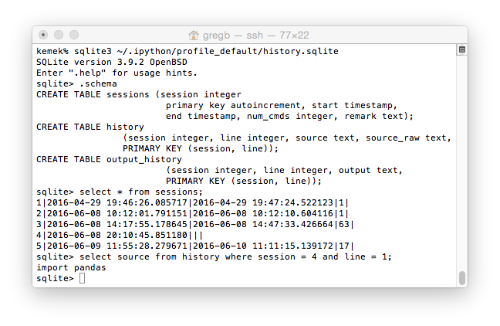
SQLite session

Slide 4
BASH (Default UNIX / Linux / OSX Shell)
How to learn
Bash programming HOWTO
Various books
Language of command shell
Has for loops, while loops, if statements
You can automate your day-to-do work

Slide 5
Time Series
Analysing events distributed over time
Rainfall, stock prices, populations, etc.
How to learn
Holt-Winters and ARIMA: Powerpoint slides in course git repository
Scipy documentation
Search for SARIMA, ARMA, time series

Slide 6
Computer Vision
Identify objects in photographs
Recognise faces (or animals)
Optical character recognition, handwriting recognition
Search for pictures: e.g. where can I buy that handbag?
Track motion – where did that burglar go?
Count objects – how many children use this swing?
How to learn
Buy (and read) all of Dr Adrian Rosebrock’s books

Slide 7
Neural Networks and Deep Learning
Best known technique for object recognition
A very good technique for classification (often beats SVM and RandomForest)
Kinda sorta models brain neural connections, as misunderstood by computer scientists in the 1970s talking to incoherent neuroscientists
How to learn
http://course.fast.ai/
Start this next week.
You will understand it with the background you have now.

